Slide 1

Lecture #6
Digital Image Processing
Frequency Filtering
1st Semester
2019-2020
Dr. Abdulhussein Mohsin Abdullah
Computer Science Dept., CS & IT College, Basrah Univ.

Slide 2
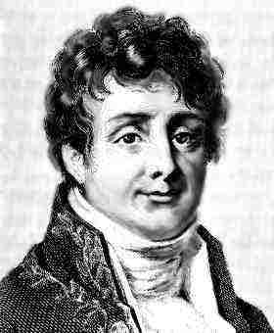
Fourier Series & The Fourier Transform
Fourier Series
Any periodic function can be expressed as the sum of sines and /or cosines of different frequencies, each multiplied by a different coefficients
Fourier Transform
Any function that is not periodic can be expressed as the integral of sines and /or cosines multiplied by a weighing function
Joseph Fourier 1768-1830

Slide 3
Periodic Functions
A function
is periodic
if it is defined for all real
and if there is some positive number,
such that

Slide 4
Fourier Series
be a periodic function with period
The function can be represented by a trigonometric series as:
What kind of trigonometric (series) functions are we talking about?

Slide 7
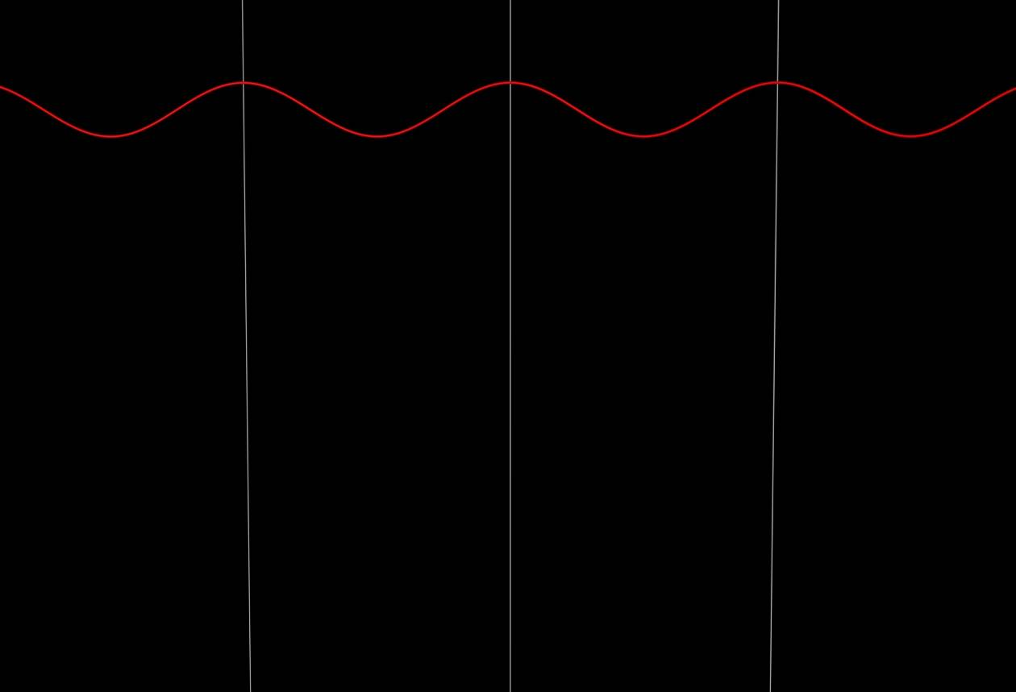
A plane wave with a single frequency

Slide 8
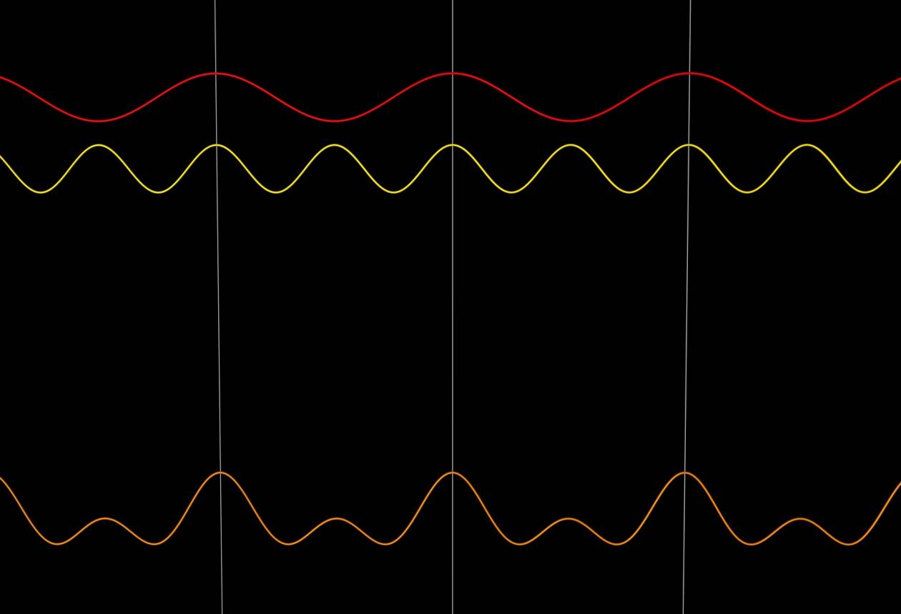
Adding a second plane wave at a different frequency results in an
intensity modulation as a function of time.

Slide 9
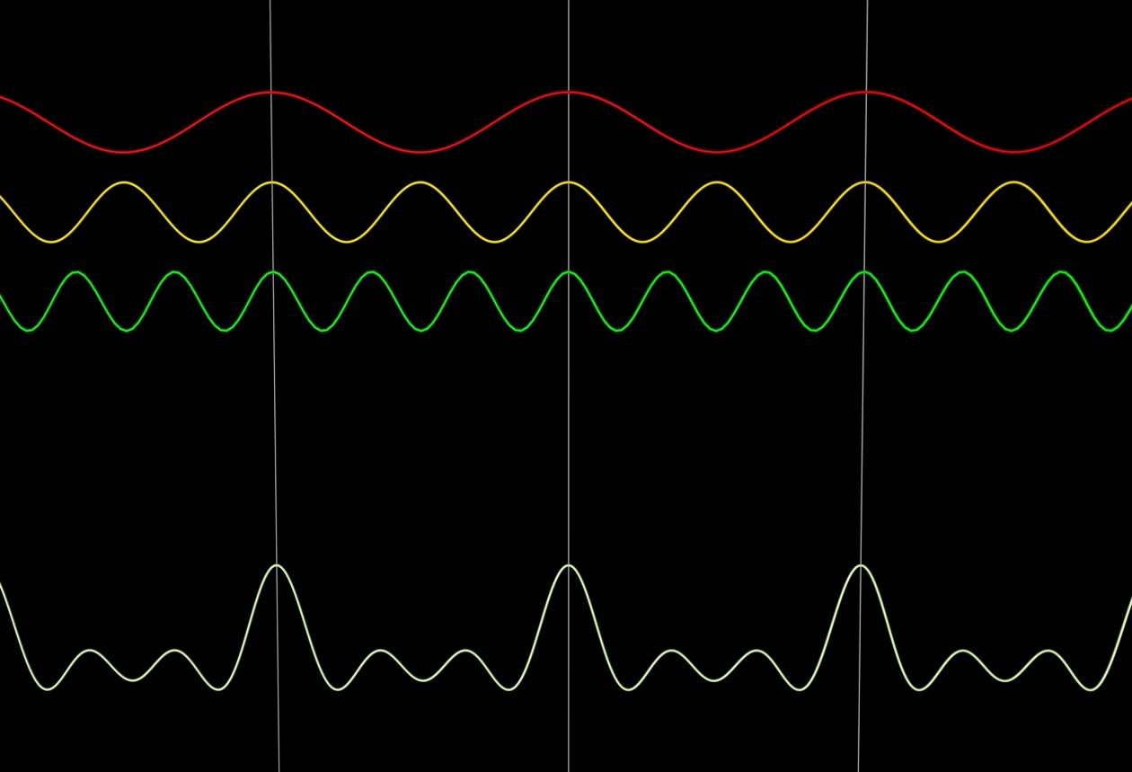

Slide 10
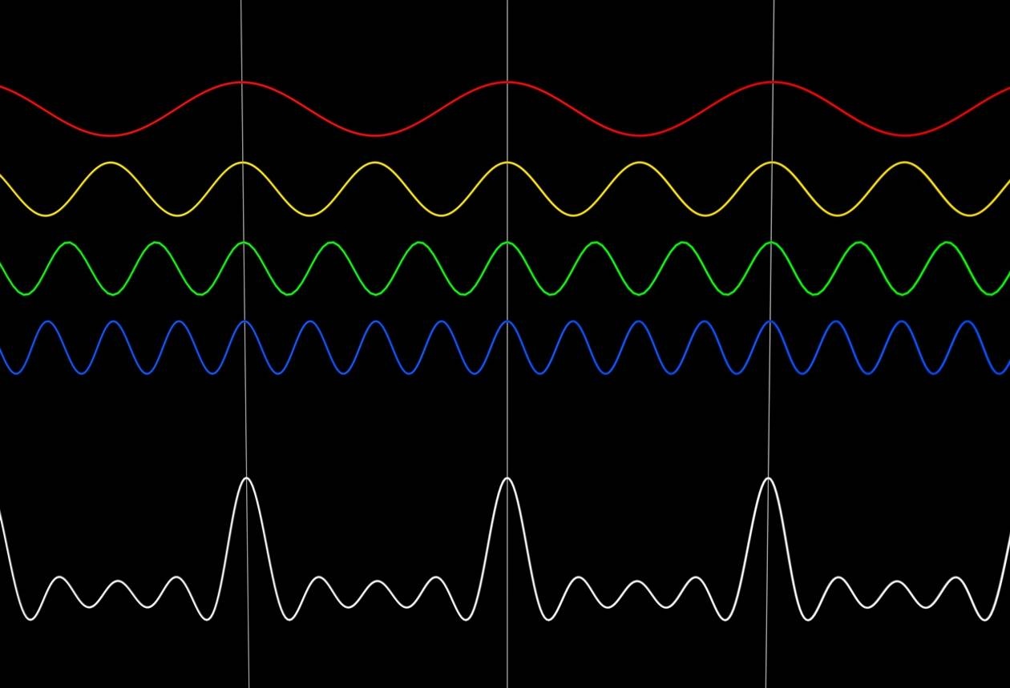

Slide 11
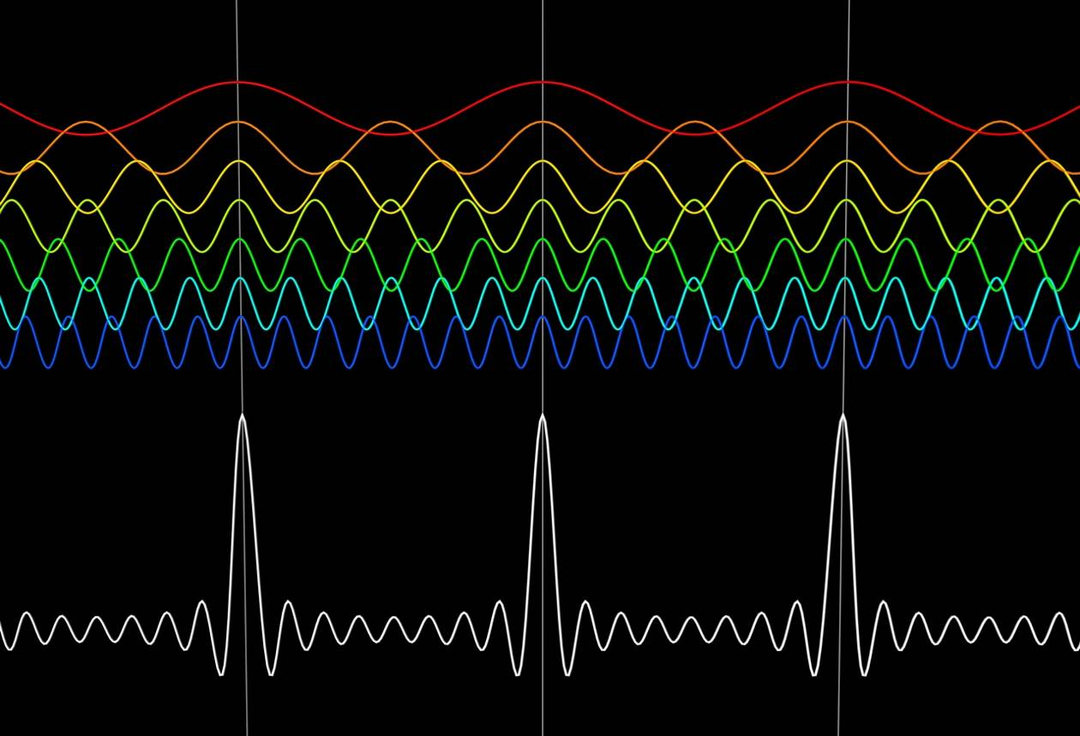

Slide 13
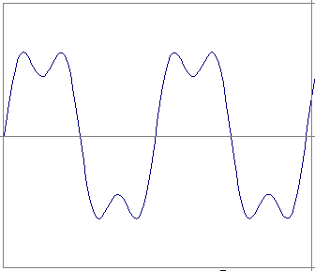
Time and Frequency
example : g(t) = sin(2pi f t) + (1/3)sin(2pi (3f) t)

Slide 14
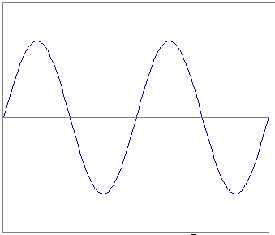
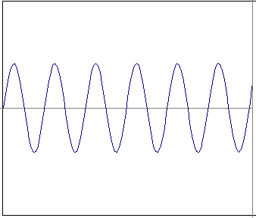
Time and Frequency
example : g(t) = sin(2pi f t) + (1/3)sin(2pi (3f) t)
=
+

Slide 15
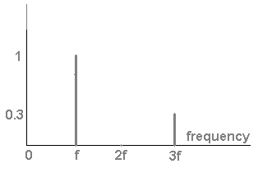
Frequency Spectra
example : g(t) = sin(2pi f t) + (1/3)sin(2pi (3f) t)
=
+

Slide 16
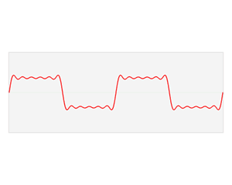

Slide 17
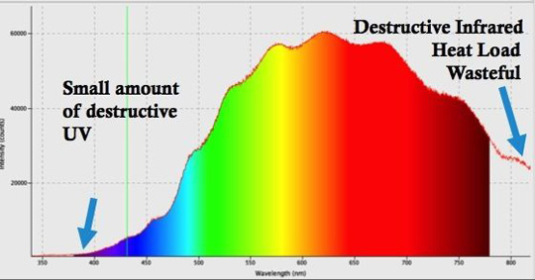
What happens when the function is not periodic?
When you add a discrete amount of harmonic waves, the resulting function always repeats at the fundamental (lowest) frequency in the series:
So how do you find the spectrum for the more general case of a nonperiodic function that exists from -∞ to ∞?
Answer: replace the discrete sum by an integral over a continuous range of frequencies:
Note that m is integer, while ω can have any (real) value

Slide 18
The Fourier Transform
f(x)
Fourier
Transform
F(ω)
F(ω)
Inverse Fourier
Transform
f(x)
These transformations allow you to calculate the frequency dependence F(ω) of a time domain function f(t), and vice versa.
There are different definitions of these transforms. The 2π can occur in several places, but the idea is generally the same.

Slide 19

Frequency Filtering: Main Steps
1. Take the FT of f(x):
2. Remove undesired frequencies:
3. Convert back to a signal:

Slide 20
Example: Removing undesirable frequencies
noisy signal
frequencies
remove high
frequencies
reconstructed
signal

Slide 21
2D Fourier transform

Slide 22
How do frequencies show up in an image?
Low frequencies correspond to slowly varying pixel intensities (e.g., continuous surface).
High frequencies correspond to quickly varying pixel intensities (e.g., edges)
Original Image
Low-passed

Slide 23
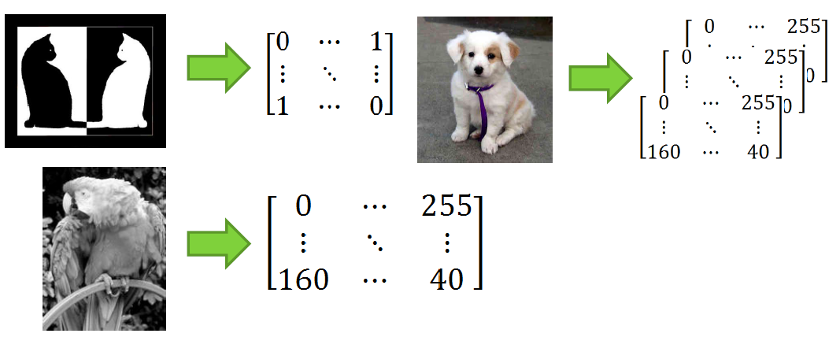

Slide 24
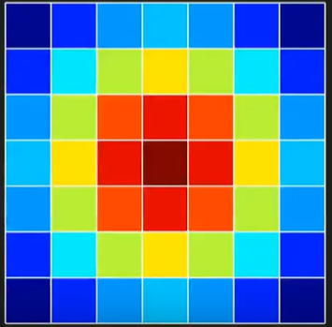
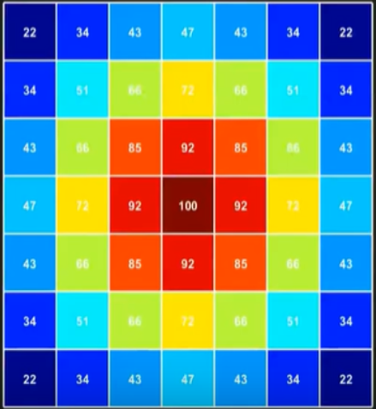


Slide 25
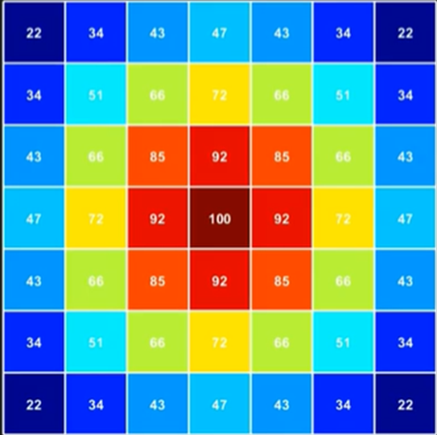
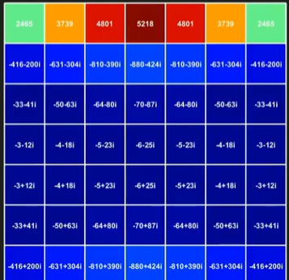
1D FT

Slide 26
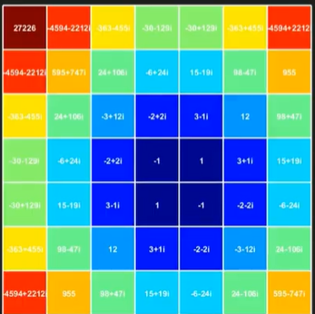
1D FT

Slide 27
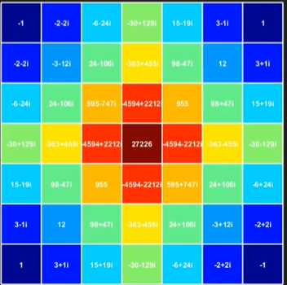

Slide 28
Why do we transform images?
Images can be analyzed in different kinds of spaces
The purpose is not to complicate the information but change the way we view the information
    •For example, two can be represented as 1+1, 2cos(0), 2sin(pi/2), 2*1, sqrt(4)
There are various types of transformations
    •Discrete Cosine Transform, Fourier Transform, Discrete Wavelet transform, and etc.

Slide 29

The equation for a 2-D Fourier Transform is:
The Inverse Fourier Transform

Slide 30
How to interpret Fourier Space?
•The Fourier Spectra shows both low and high frequency components
  Low frequencies are near the origin
  High frequencies are away from the origin

Slide 31
Centered spectra
It is useful to visualize a centered spectrum with the origin of the coordinate system (0, 0) in the middle of the spectrum.
Assume the original spectrum is divided into four quadrants. The small gray-filled squares in the corners represent positions of low frequencies.
Due to the symmetries of the spectrum the quadrant positions can be swapped diagonally and the low frequencies locations appear in the middle of the image.

Slide 32
Filtering in frequency domain
Filtration in the frequency domain. Conversion to the ‘frequency domain’, filtration there, and the conversion back.

Slide 33

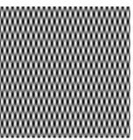










n
m
Cos ($18π$n/256)
Cos ($50π$n/256)
Cos ($18π$m/256)
Cos ($50π$m/256)
u=0, v= $18π$n/256
u=0, v= $50π$n/256
u=$18π$n/256, v=0
u=$50π$n/256, v=0
v
u
Cos ($50π$n/256)Cos ($18π$n/256)
u=$18π$n/256, v= $50π$n/256

Slide 34
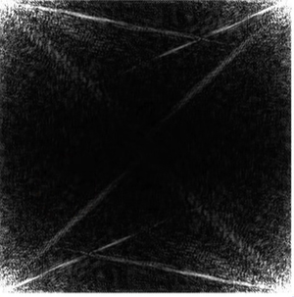
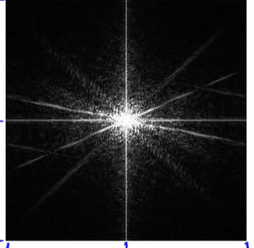
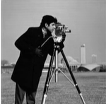






|F(u, v)|
|F(u, v)|
f(m, n)
0
$$−π$$
u
0
m
n
$$2π$$
$$π$$
0
v
$$2π$$
$$−π$$
0
$$π$$

